Slide 1

ElectViz
Election Data Visualization for Media
Presented by Team A
M V S Sreenidhi
Munish Karthikeyan
Banu Sneha
Chetan Kurkut
Subedar Bhargavi

Slide 2
Problem Statement
In the high-stakes environment of elections, news agencies require accurate, real-time, and historical visualizations to enhance their reporting. This project uses Power BI to integrate public election datasets and build dashboards that deliver insights into vote shares, turnout rates, party trends, and constituency-level performance. These dashboards enable journalists and editorial teams to analyze and present complex electoral data with clarity and accuracy.
Module-1
Data Integration and Modeling
Module-2
Historical Trends Analysis
Module-3
Real- Time Results
Module-4
Turnout and Demographics Analysis
Module-5
Party and Candidate Performance Tracker

Slide 3



Data Sources, Understanding & Collection
Collected public election datasets from trusted platforms.
Election Commission of India (ECI) used as the primary data source.
India Votes used for vote share, turnout, and margin data.
Reviewed datasets to understand structure and key attributes.
Imported data from CSV, Excel, and web-based sources.
Data Cleaning, Integration & Transformation
Identified missing, inconsistent, and unknown values.
Removed null values, duplicate records, and invalid entries.
Standardized candidate, party, and constituency names.
Converted votes, margins, turnout, and year into numeric formats.
Merged data across years, states, and constituencies.
Resolved conflicts using ECI as the reference source.

Slide 4
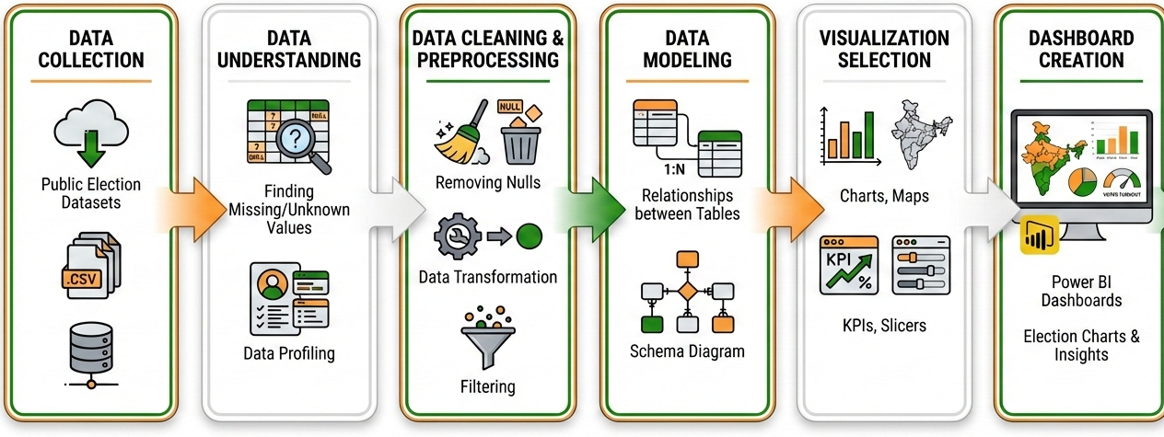
Data Modeling & Dashboard Preparation
Built the foundation stage of the election data workflow.
Converted raw data into accurate, analysis-ready format.
Designed a Star Schema for efficient analysis.
Created Fact_ElectionResults table for votes and outcomes.
Developed dimension tables: Candidate, Party, Constituency, Date.
Optimized the model for fast Power BI dashboards and reporting.
Tools and Technologies used: Power BI,Microsoft Excel

Slide 5
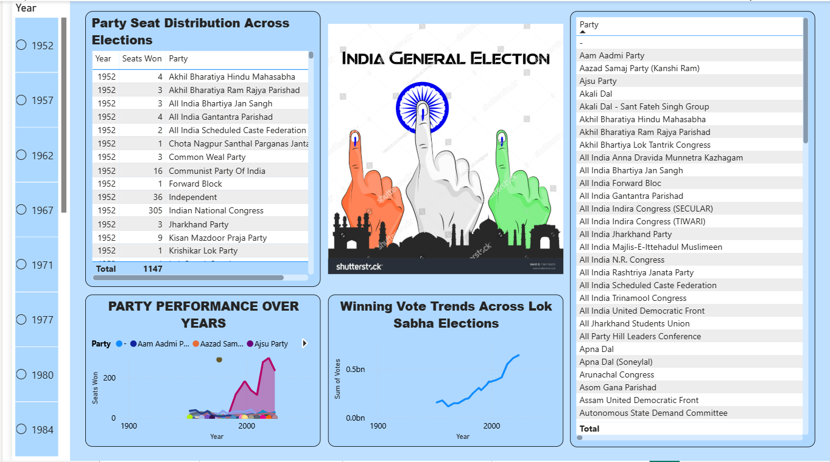
Historical Trends Dashboard for Lok Sabha Election

Slide 6
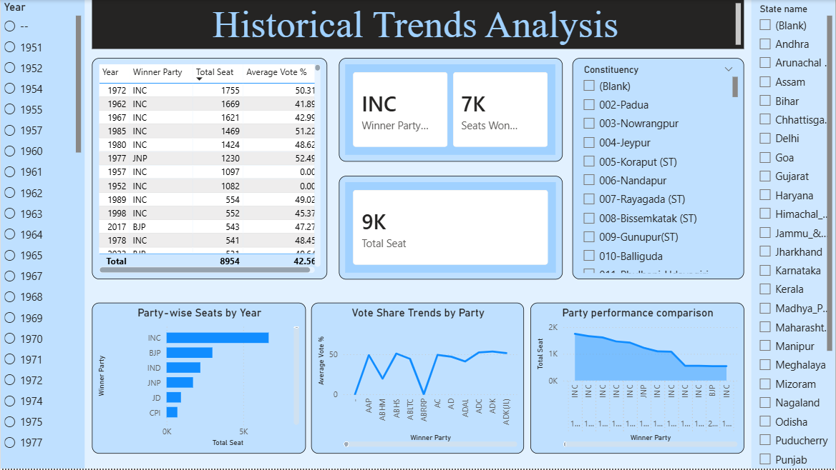
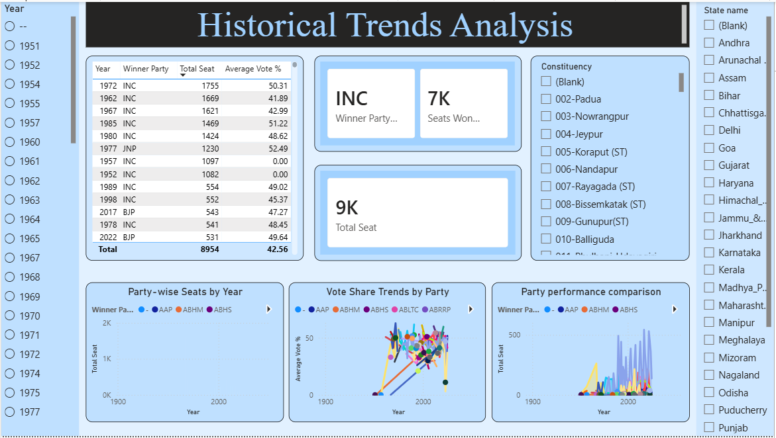
Historical Trends Dashboard for Vidhan Sabha Election

Slide 7
Applications of the Historical Trends Dashboards
Analyze historical election trends, party dominance, and shifts over time.
Compare party-wise seat distribution and vote share across elections.
Track performance growth or decline of major and regional parties.
Identify winning patterns and vote-to-seat conversion efficiency.
Perform interactive drill-down analysis by year, state, constituency, and party.
Support academic research, political strategy, and election forecasting.
02
03
04
Union Legislature

Slide 8
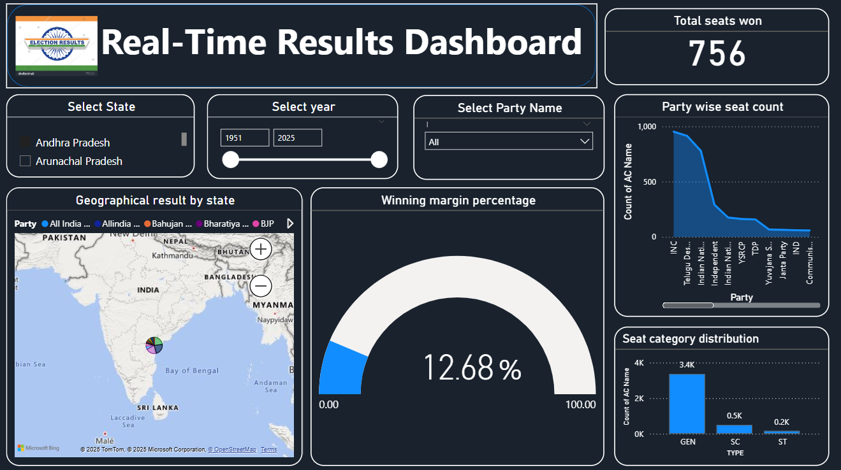
Real-Time Results Dashboard

Slide 9
Key Insights
INC secured the highest number of seats among all parties.
Regional parties like TDP and YSRCP show strong performance in
specific states.
The winning margin percentage shows how competitive the elections
were.
Party-wise seat distribution clearly highlights differences in performance
across parties.
GEN category holds most of the seats, with fewer seats in SC and ST
categories.

Slide 10
Turnout and Demographics Analysis
Scope of the Module
Covers voter turnout analysis across gender, geography (urban–rural), and time periods to understand participation patterns.
Objective
To identify voting behavior differences and demographic participation gaps that influence election outcomes.
Level of Analysis
Enables analysis at national, state, and constituency levels with year-wise drill-downs.
Key Features
Urban vs rural turnout comparison using interactive visuals to highlight regional disparities.
Visualization & Insights
Uses donut chart and pie chart to present demographic slices clearly and support data-driven insights.

Slide 11
Demographics Insights
The dashboard shows the number of winning candidates with state and year filters for easy regional and time-based analysis.
It highlights gender-wise representation, revealing a clear dominance of male candidates among winners.
The comparison of urban and rural areas explains differences in gender representation across constituencies.
The elector share analysis shows rural voters form a larger base, indicating their strong influence on election outcomes.
Tracking electors and voters over time helps identify long-term participation trends.
Key Insight: The dashboard exposes representation gaps and changing voter participation patterns across gender, geography, and time.

Slide 12
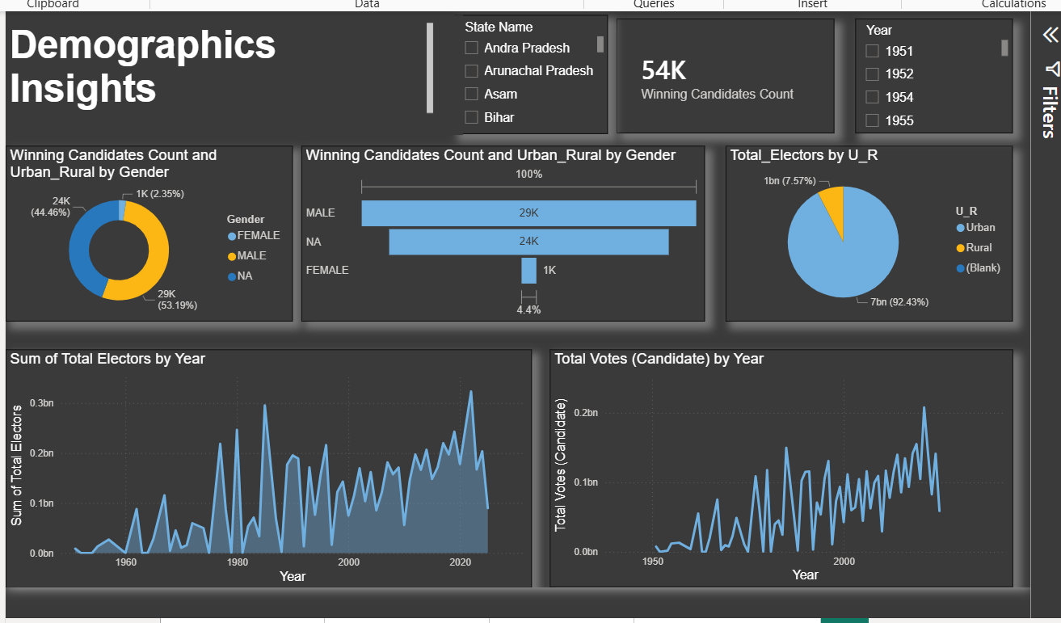
Demographics Dashboard

Slide 13
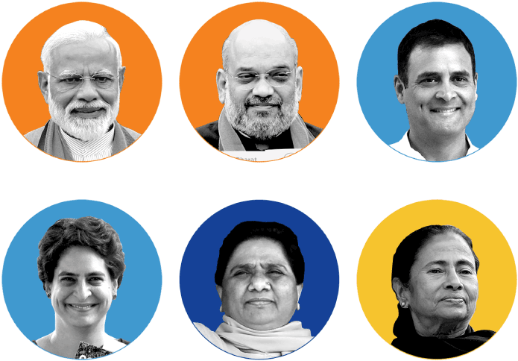
Party & Candidate Performance Tracker
Objective of the Module
To analyze the performance of political parties and candidates using election results data.
Scope of Analysis
Party-wise vote share and seat performance.
Candidate-level insights using election metrics such as total votes, electors, poll% etc.
Key Features
Interactive filters for year and state
Drill-down from national to constituency level
Metric-based performance evaluation

Slide 14



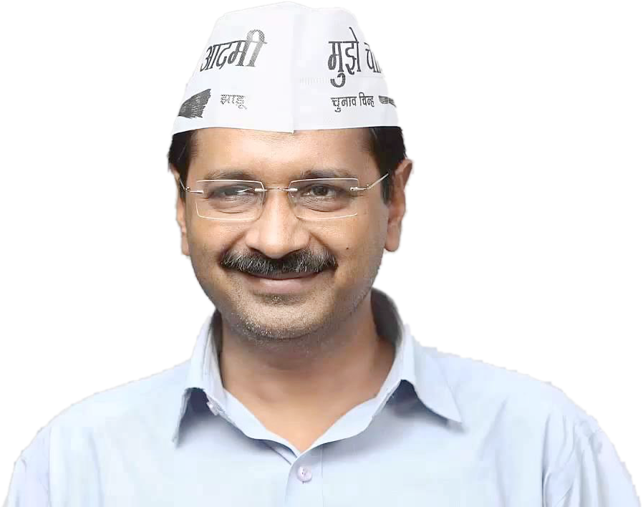
Candidate Performance Analysis
Party Wise Performance
• Clustered bar chart representing total poll percentage by party.
• Enables direct comparison of vote share across political parties.
• Highlights dominant national parties versus regional and independent parties.
• Distinct colors are used to represent parties (e.g., Green for Congress, Orange for BJP) for easy identification.
• Helps identify overall party strength and electoral presence.
• Line chart used to visualize candidate-wise performance across multiple election years. • Filters applied to select top 5 prominent candidates for focused analysis. • Enables year-wise comparison of individual candidate performance. • Helps identify performance trends, consistency, and variations over time. • Interactive filtering allows dynamic and flexible analysis.

Slide 15
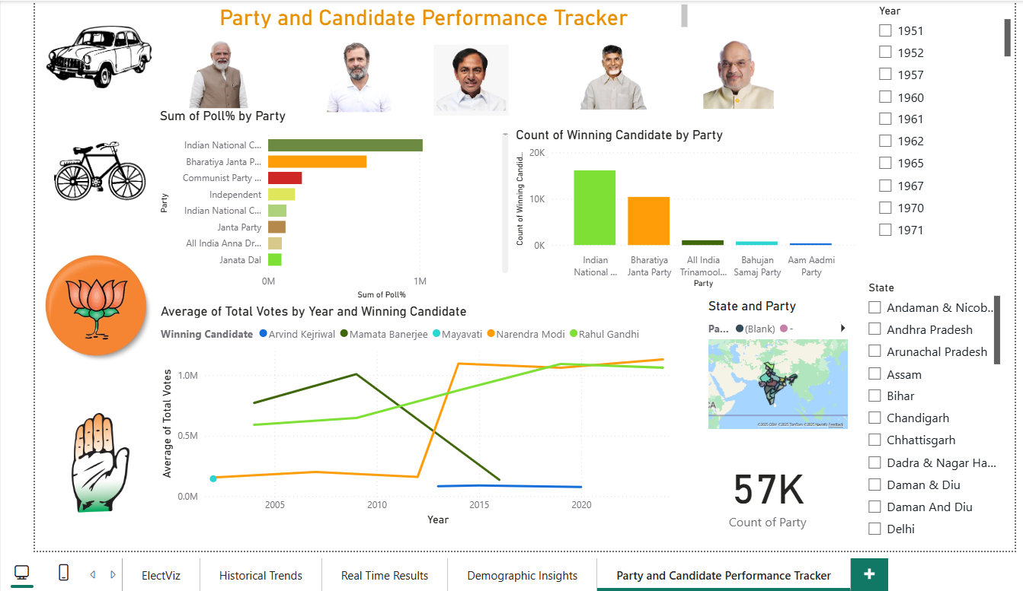
Dashboard for Party and Candidate Performance Tracker

Slide 16
Conclusion
Future Scope and Applications
***
Initially, the election data was complex to analyze, but through our dashboards it has become clear and easy to understand.
Users can easily identify winning candidates and parties across different election years with just a few clicks.
3. The dashboards enable quick comparison and deeper insights at both state and constituency levels. 4. Overall, this analysis helps in understanding historical election trends for supports faster, decision making.
This project enables journalists to analyze historical election data to identify voting patterns and shifts in party performance over time.
News media platforms can use the dashboard to compare election outcomes across states and years in a clear and transparent manner.
3. Further enhancements to the project can enable contributions to election forecasting and public disclosure.

